Slide 1

Micro-course Learning Pathway Builder

Slide 2
The Purpose of this Micro-course Learning Pathway Builder
Welcome – The purpose of this slide deck is to help you build engaging learning pathways for your students. You can use it to:
Identify the instructional activities you will include in your course
Sequence those instructional activities into learning pathways
Apply Kadenze’s Technology Enabled Creative Learning (TECL) framework to guide the emerging structure of your course
Design instructional activities and learning pathways to maximise asynchronous delivery (students can access the course content at anytime and from anywhere)
Edit and finalise the text for each activity and so upload your course with high version control
The five slides which follow are prompts from our Technology Enabled Creative Learning (TECL) framework reminding you of the key factors to when assembling the form and flow of your course.

Slide 3
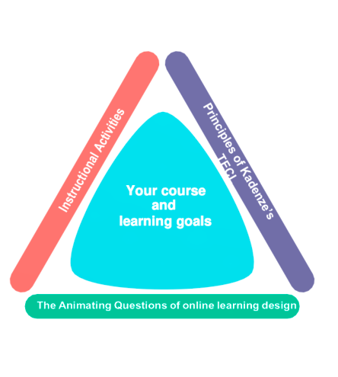
Prompt 1: Design Your Course: applying Technology Enabled Creative Learning (TECL)
Clarify and identify your goals for the course
Apply the three dimensions of Kadenze’s Technology Enabled Creative Learning (TECL).
The Principles of Kadenze’s Technology Enabled Creative Learning (TECL).
Instructional Activities to be selected and sequenced to create effective learning pathways.
The animating questions guiding all effective online pedagogy.
Remember your course will delivered in an asynchronous mode of delivery.
Principles of Kadenze’s TECL
Instructional Activities

Slide 4
Prompt 2: The 8 Principles of Kadenze’s TECL
Create: Making things, early in a course and often.
Tell stories: building your learning in and through short and long narratives.
Simulate: using ‘make believe’, realistic simulation and branching scenarios for analysis.
Observe: repeatedly, over time and for depth.
Let meaning emerge: Let curiosity lead. Withhold answers.
Let meaning come together: ensure coherence by synthesizing what has been tried, observed, considered.
Reflect: to gain deeper and fresh perspectives to share.
Master: practice skills through creative exercises and presentations.

Slide 5
Prompt 3: Instructional Activities to consider including
Completing a creative task
Listen to audio
Simulation
Multi-media presentation
Digital Case Study
Post to Forum
Video Conference
Post to Gallery
Set readings
Reflection activity
Research to discover more
Surveys
Video – found
Post on social media
Video – bespoke
Pre-text with artefacts
Game
H5P templates
Quiz

Slide 6
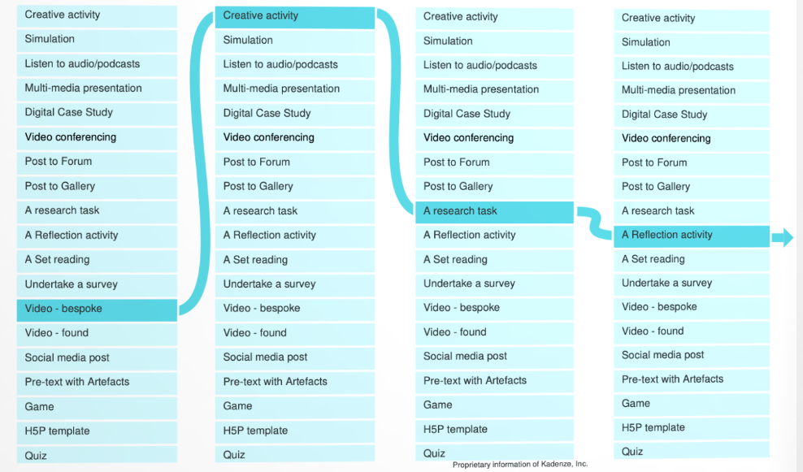
Prompt 4: Mapping a Learning Pathway

Slide 7
Prompt 5: Key Questions to animate learner engagement
Sequencing:
How will I position and pace each activity and learning sequence?
Feedback
How will I help students see the progress they have made?
Questioning
How will I craft and position key questions to deepen learning?
Community & Collaboration
How can I enable students to learn from each other?
Passion & Rewards
How do the activities I select amplify students’ motivation?
Consistency & Coherence
How can I help students recognize patterns?
Complex Communications
How can I make student communication tasks more complex and rich?
Presence
How will I communicate my enthusiasm and presence as a teacher?

Slide 8
How to use this Micro-course Learning Pathway Builder
Begin by making a copy of this document within which you will build your course.
Use each slide to represent a ‘lesson’. Lessons will then be queued into a playlist for the ‘session’. Create as many slides as there are lessons in the session.You will decide how many lessons each session will have.
Each lesson is built around one ot two instructional activities which are presented to learners via videos, multi-media presentations, text instructions and so on.
Micro-courses are not formally assessed for credit. We recommend that if students complete the Micro-course activities or coursework/assignments, then they receive 100% for assessment in order to receive a Certificate of Completion.
Note: One effective Kadenze course that’s free to audit is the “The Basics of Teaching Artistry.” It illustrates how lessons are sequenced into a playlist to structre Sessions or Learning Pathways.

Slide 9
Add your details
YOUR COURSE TITLE | INSTRUCTOR NAME(S) | YEAR
Notes:
Course Title

Slide 10
Course Overview (List the instructional activities and duplicate this slide if more sessions are needed)
Session 1
Session 2
Session 3
ONE SENTENCE OVERVIEW
ACTIVITY 1: Introduction - video
ACTIVITY 2:
ACTIVITY 3:
ACTIVITY 4:
ACTIVITY 5:
ONE SENTENCE OVERVIEW
ACTIVITY 1:
ACTIVITY 2:
ACTIVITY 3:
ACTIVITY 4:
ACTIVITY 5:
ONE SENTENCE OVERVIEW
ACTIVITY 1:
ACTIVITY 2:
ACTIVITY 3:
ACTIVITY 4:
ACTIVITY 5:

Slide 11
Title Session 1

Slide 12
Lesson #1: Introduction Video
This slide is a placeholder for the first video lesson. You can use this slide to draft an outline script of the key ideas that you will touch on. This first video might simply be narrated content, or you might edit the video to include other images.
Some starting prompts are:
Hello, welcome to….
In this course we will ….
You’ll ……
To take this course, you will need …..

Slide 13
Lesson #2: Key Concepts Video
Continue to use these slides to draft your script.
Remember, your video may include edits that ‘cut-away’ to a demonstration, image or slide with instructions.
Tip: You might want to explain to people how to use the forum and gallery.

Slide 14
Lesson #3: Activity (written on slide)
You may include a slide with written information.

Slide 15
Lesson #4: Closing Video Reflection
Perhaps instruction here is an activity that includes reflection using the student forum.

Slide 16
Session 2

Slide 17
Lesson #1: Introduction Video
Lesson 1 of the second session may include a quick overview of the key concepts in the first session.
You may want to do an overview of what is to come in this session, materials the students will need, and reinforce the use of the gallery and forum.
Continue to copy the lesson slides as needed.

Slide 18
Lesson #2:
Continue to use these slides to draft your script.

Slide 19
Keep building….
Continue to create slides as necessary until the structure of all sessions have been settled…
Once the learning pathway for each session is clear, you can move on to the next phase of Micro-course building. From Author and Learning Designer to Producer.
As the Producer of your course you will now prepare in detail each lesson or instructional activity for your learners.

